Slide 1
COM2067
Chapter 10: Efficient Binary Trees
Data Structures Using C, Second Edition

Slide 2
Binary Search Trees
Operations on Binary Search Trees
Threaded Binary Trees
AVL Trees
Red-Black Trees
Splay Trees

Slide 3
Binary Search Trees
We have already discussed binary trees in the previous chapter.
A binary search tree, also known as an ordered binary tree, is a variant of binary trees in which the nodes are arranged in an order.
In a binary search tree, all the nodes in the left sub-tree have a value less than that of the root node.
Correspondingly, all the nodes in the right sub-tree have a value either equal to or greater than the root node.
The same rule is applicable to every sub-tree in the tree.
(Note that a binary search tree may or may not contain duplicate values, depending on its implementation.)

Slide 4
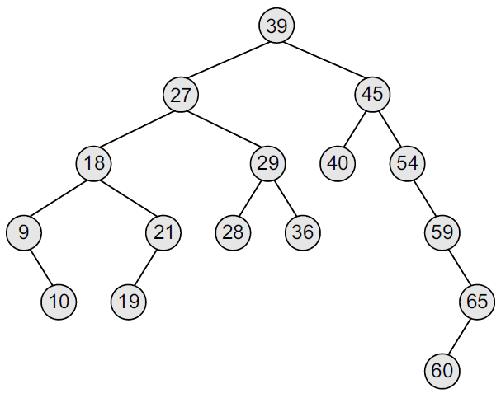
Binary Search Trees
The root node is 39. The left sub-tree of the root node consists of nodes 9, 10, 18, 19, 21, 27, 28, 29, and 36.
All these nodes have smaller values than the root node.
The right sub-tree of the root node consists of nodes 40, 45, 54, 59, 60, and 65.
Recursively, each of the sub-trees also obeys the binary search tree constraint.
For example, in the left sub-tree of the root node, 27 is the root and all elements in its left sub-tree (9, 10, 18, 19, 21) are smaller than 27, while all nodes in its right sub-tree (28, 29, and 36) are greater than the root node’s value.

Slide 5
Binary Search Trees
Since the nodes in a binary search tree are ordered, the time needed to search an element in the tree is greatly reduced.
Whenever we search for an element, we do not need to traverse the entire tree. At every node, we get a hint regarding which sub-tree to search in.
For example, in the given tree, if we have to search for 29, then we know that we have to scan only the left sub-tree. If the value is present in the tree, it will only be in the left sub-tree, as 29 is smaller than 39 (the root node’s value). The left sub-tree has a root node with the value 27. Since 29 is greater than 27, we will move to the right sub-tree, where we will find the element.
Due to its efficiency in searching elements, binary search trees are widely used in dictionary problems where the code always inserts and searches the elements that are indexed by some key value.

Slide 6
Binary Search Trees
Binary search trees also speed up the insertion and deletion operations.
The tree has a speed advantage when the data in the structure changes rapidly.
Binary search trees are considered to be efficient data structures especially when compared with sorted linear arrays and linked lists.
In binary search tree, the average running time of a search operation is O(log₂n), as at every step, we eliminate half of the sub-tree from the search process.
In a sorted array, searching can be done in O(log₂n) time, but insertions and deletions are quite expensive.
In contrast, inserting and deleting elements in a linked list is easier, but searching for an element is done in O(n) time.

Slide 7
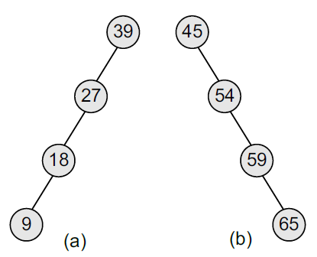
Binary Search Trees
However, in the worst case, a binary search tree will take O(n) time to search for an element.
The worst case would occur when the tree is a linear chain of nodes as given in Figure.
To summarize, a binary search tree is a binary tree with the following properties:
The left sub-tree of a node N contains values that are less than N’s value.
The right sub-tree of a node N contains values that are greater than N’s value.
Both the left and the right binary trees also satisfy these properties and, thus, are binary search trees.

Slide 8
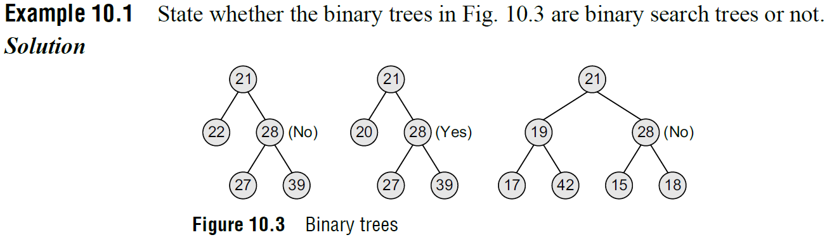
Binary Search Trees

Slide 9
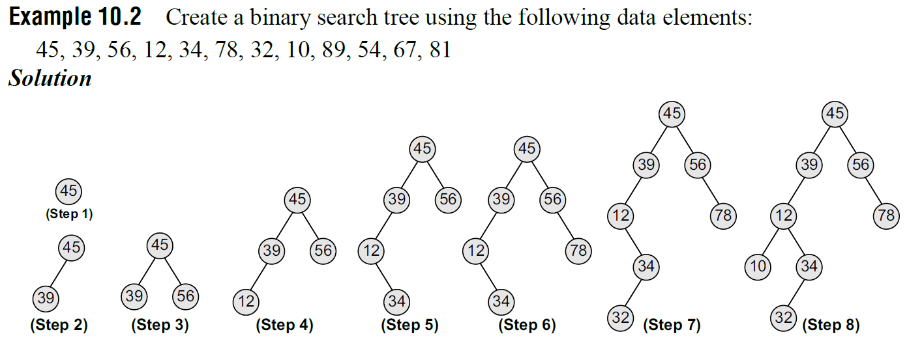
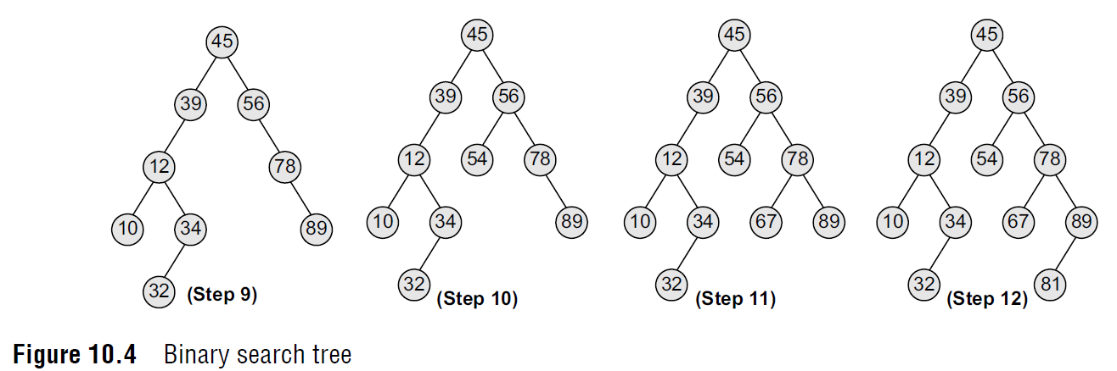
Binary Search Trees

Slide 10
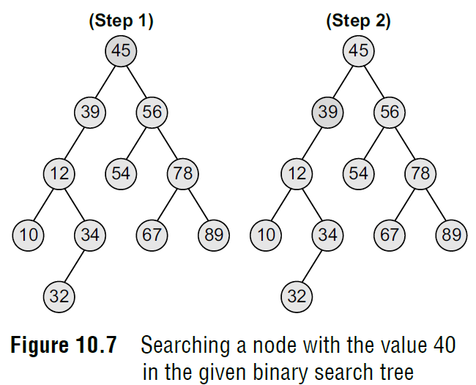
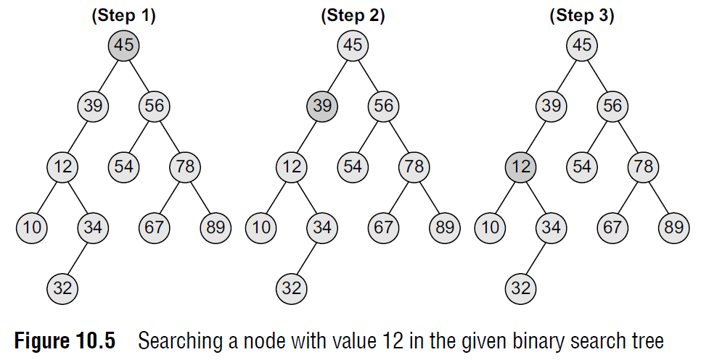
Searching for a Node in a Binary Search Tree
The search function is used to find whether a given value is present in the tree or not.
The searching process begins at the root node. The function first checks if the binary search tree is empty. If it is empty, then the value we are searching for is not present in the tree.
So, the search algorithm terminates by displaying an appropriate message.
However, if there are nodes in the tree, then the search function checks to see if the key value of the current node is equal to the value to be searched.
If not, it checks if the value to be searched for is less than the value of the current node, in which case it should be recursively called on the left child node.
In case the value is greater than the value of the current node, it should be recursively called on the right child node.

Slide 11
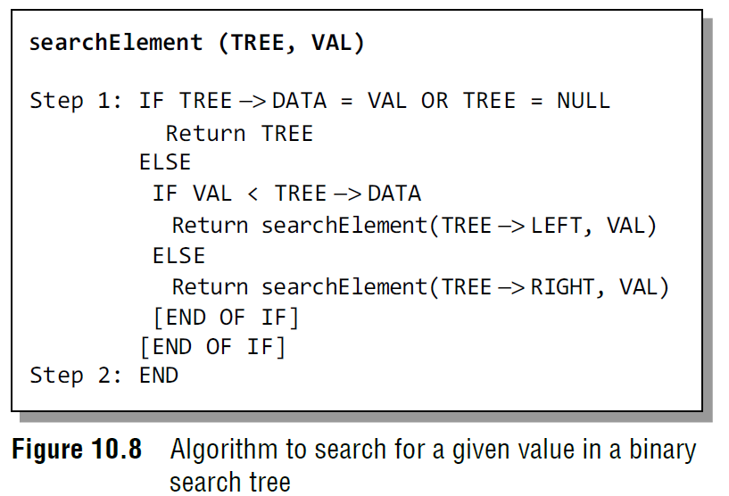
Searching for a Node in a Binary Search Tree
In Step 1, we check if the value stored at the current node of TREE is equal to VAL or if the current node is NULL, then we return the current node of TREE.
Otherwise, if the value stored at the current node is less than VAL, then the algorithm is recursively called on its right sub-tree, else the algorithm is called on its left sub-tree.

Slide 12
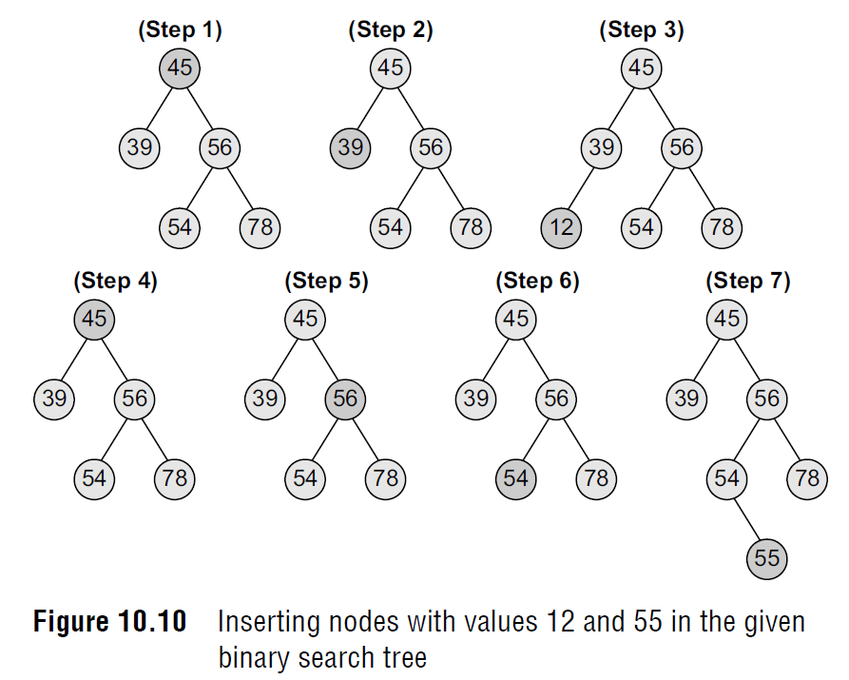
Inserting a New Node in a Binary Search Tree
The insert function is used to add a new node with a given value at the correct position in the binary search tree.
Adding the node at the correct position means that the new node should not violate the properties of the binary search tree.
The initial code for the insert function is similar to the search function. This is because we first find the correct position where the insertion has to be done and then add the node at that position.
The insertion function changes the structure of the tree. Therefore, when the insert function is called recursively, the function should return the new tree pointer.

Slide 13
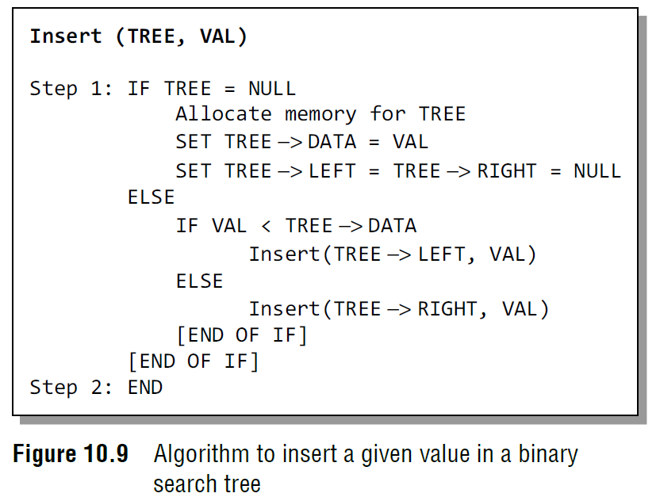
Inserting a New Node in a Binary Search Tree
In Step 1 of the algorithm, the insert function checks if the current node of TREE is NULL. If it is NULL, the algorithm simply adds the node, else it looks at the current node’s value and then recurs down the left or right sub-tree.
If the current node’s value is less than that of the new node, then the right sub-tree is traversed, else the left sub-tree is traversed.
The insert function continues moving down the levels of a binary tree until it reaches a leaf node. The new node is added by following the rules of the binary search trees.
That is, if the new node’s value is greater than that of the parent node, the new node is inserted in the right sub-tree, else it is inserted in the left sub-tree.
The insert function requires time proportional to the height of the tree in the worst case.
It takes O(log n) time to execute in the average case and O(n) time in the worst case.

Slide 14
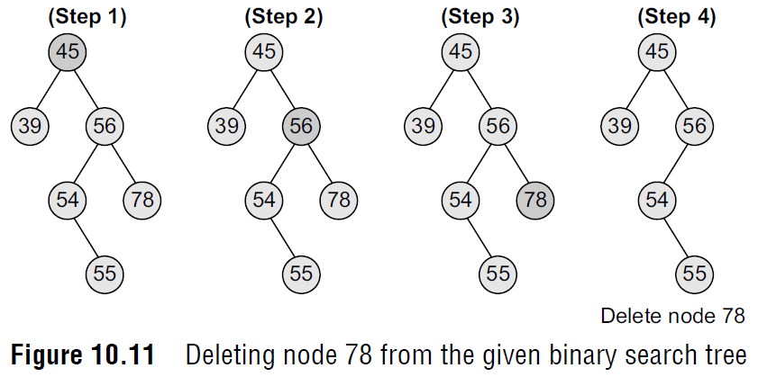
Deleting a Node from a Binary Search Tree
Case 1: Deleting a Node that has No Children
Look at the binary search tree given in Figure.
If we have to delete node 78, we can simply remove this node without any issue.
This is the simplest case of deletion.

Slide 15
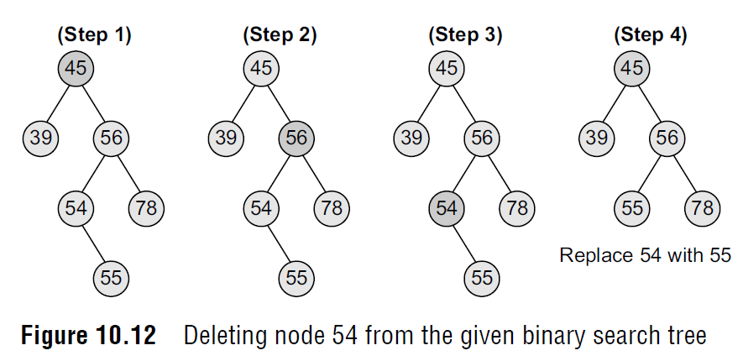
Deleting a Node from a Binary Search Tree
Case 2: Deleting a Node with One Child
To handle this case, the node’s child is set as the child of the node’s parent. In other words, replace the node with its child.
Now, if the node is the left child of its parent, the node’s child becomes the left child of the node’s parent.
Correspondingly, if the node is the right child of its parent, the node’s child becomes the right child of the node’s parent.
Look at the binary search tree shown in Figure and see how deletion of node 54 is handled.

Slide 16
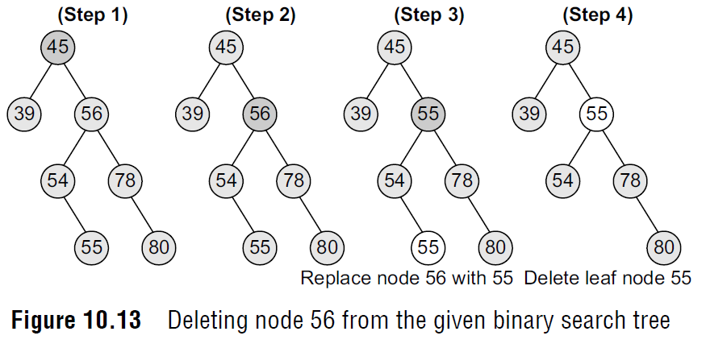
Deleting a Node from a Binary Search Tree
Case 3: Deleting a Node with Two Children
To handle this case, replace the node’s value with its in-order predecessor (largest value in the left sub-tree) or in-order successor (smallest value in the right sub-tree).
The in-order predecessor or the successor can then be deleted using any of the above cases.
Look at the binary search tree given in Fig. 10.13 and see how deletion of node with value 56 is handled.

Slide 17
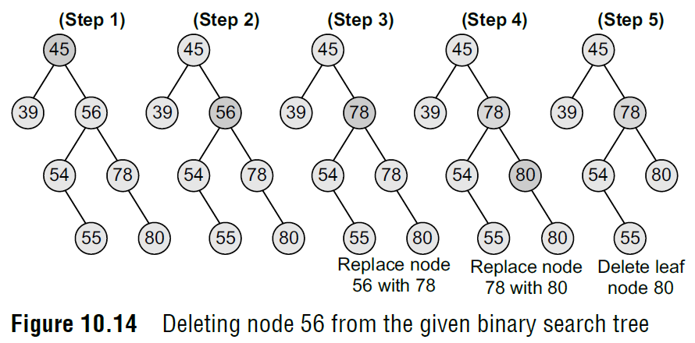
Deletiang a Node from a Binary Search Tree
Case 3: Deleting a Node with Two Children
To handle this case, replace the node’s value with its in-order predecessor (largest value in the left sub-tree) or in-order successor (smallest value in the right sub-tree).
The in-order predecessor or the successor can then be deleted using any of the above cases.
This deletion could also be handled by replacing node 56 with its in-order successor, as shown in Fig. 10.14.

Slide 18
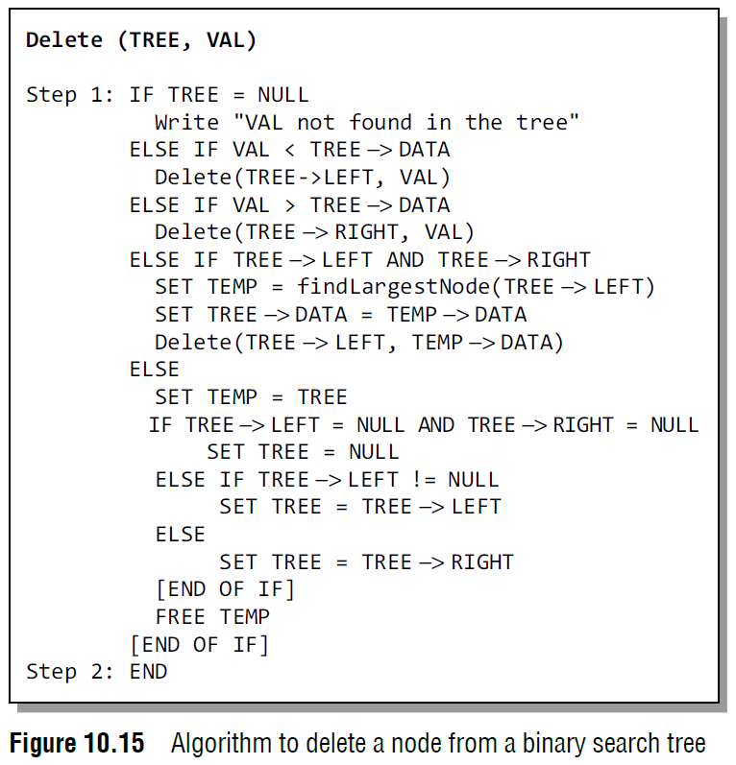
Deleting a Node from a Binary Search Tree

Slide 19
Deleting a Node from a Binary Search Tree
In Step 1 of the algorithm, we first check if TREE=NULL, because if it is true, then the node to be deleted is not present in the tree.
However, if that is not the case, then we check if the value to be deleted is less than the current node’s data. In case the value is less, we call the algorithm recursively on the node’s left sub-tree, otherwise the algorithm is called recursively on the node’s right sub-tree.
Note that if we have found the node whose value is equal to VAL, then we check which case of deletion it is. If the node to be deleted has both left and right children, then we find the in-order predecessor of the node by calling findLargestNode(TREE -> LEFT) and replace the current node’s value with that of its in-order predecessor.
Then, we call Delete(TREE -> LEFT, TEMP -> DATA) to delete the initial node of the in-order predecessor. Thus, we reduce the case 3 of deletion into either case 1 or case 2 of deletion.
If the node to be deleted does not have any child, then we simply set the node to NULL. Last but not the least, if the node to be deleted has either a left or a right child but not both, then the current node is replaced by its child node and the initial child node is deleted from the tree.
The delete function requires time proportional to the height of the tree in the worst case.
It takes O(log n) time to execute in the average case and W(n) time in the worst case.

Slide 20
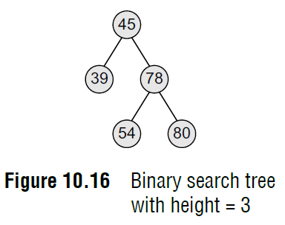
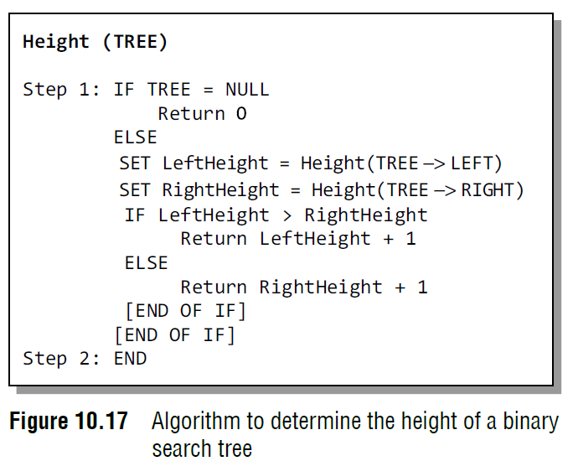
Determining the Height of a Binary Search Tree
In order to determine the height of a binary search tree, we calculate the height of the left sub-tree and the right sub-tree.
Whichever height is greater, 1 is added to it.
Look at Fig. 10.16. Since the height of the right sub-tree is greater than the height of the left sub-tree, the height of the tree = height (right sub-tree) + 1= 2 + 1 = 3.
Figure 10.17 shows a recursive algorithm that determines the height of a binary search tree.
In Step 1 of the algorithm, we first check if the current node of the TREE = NULL. If the condition is true, then 0 is returned to the calling code.
Otherwise, for every node, we recursively call the algorithm to calculate the height of its left sub-tree as well as its right sub-tree.
The height of the tree at that node is given by adding 1 to the height of the left sub-tree or the height of right sub-tree, whichever is greater.

Slide 21
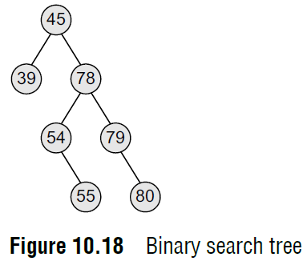
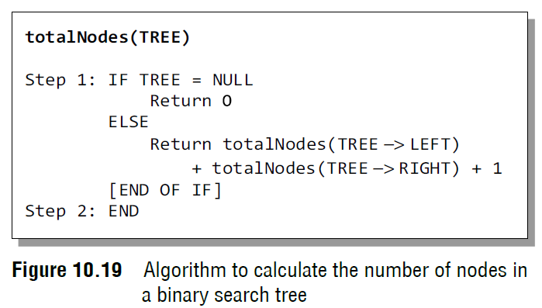
Determining the Number of Nodes
To calculate the total number of elements/nodes in the tree, we count the number of nodes in the left sub-tree and the right sub-tree.
Number of nodes = totalNodes(left sub–tree) + totalNodes(right sub–tree) + 1
Consider the tree given in Fig. 10.18. The total number of nodes in the tree can be calculated as:
Total nodes of left sub–tree = 1
Total nodes of left sub–tree = 5
Total nodes of tree = (1 + 5) + 1
Total nodes of tree = 7
Figure 10.19 shows a recursive algorithm to calculate the number of nodes in a binary search tree. For every node, we recursively call the algorithm on its left sub-tree as well as the right sub-tree. The total number of nodes at a given node is then returned by adding 1 to the number of nodes in its left as well as right sub-tree. However if the tree is empty, that is TREE = NULL, then the number of nodes will be zero.

Slide 22
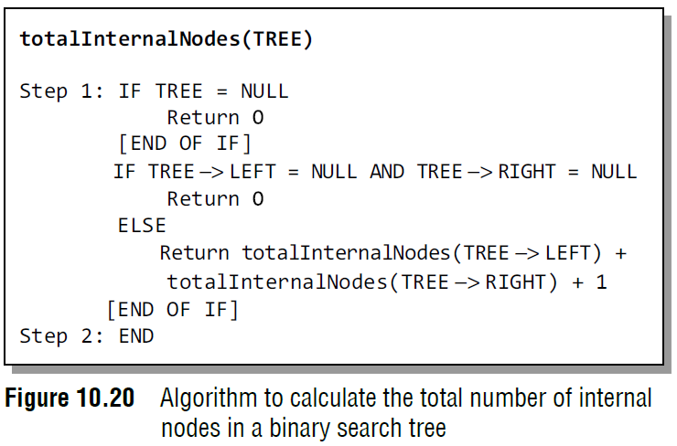
Determining the Number of Internal Nodes
To calculate the total number of internal nodes or non-leaf nodes, we count the number of internal nodes in the left sub-tree and the right sub-tree and add 1 to it
Numberofinternalnodes = totalInternalNodes(left sub–tree)
+ totalInternalNodes(right sub–tree) + 1
The total number of internal nodes in the tree given in Fig. 10.18 can be calculated as:
Total internal nodes of left sub–tree = 0
Total internal nodes of right sub–tree = 3
Total internal nodes of tree = (0 + 3) + 1= 4
Figure 10.20 shows a recursive algorithm to calculate the total number of internal nodes in a binary search tree. For every node, we recursively call the algorithm on its left subtree as well as the right sub-tree. The total number of internal nodes at a given node is then returned by adding internal nodes in its left as well as right sub-tree.
However, if the tree is empty, that is TREE = NULL, then the number of internal nodes will be zero. Also if there is only one node in the tree, then the number of internal nodes will be zero.

Slide 23
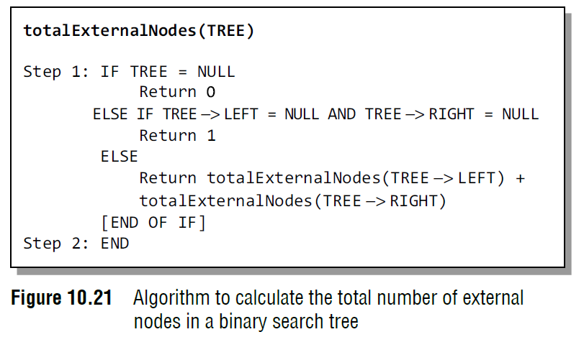
Determining the Number of External Nodes
To calculate the total number of external nodes or leaf nodes, we add the number of external nodes in the left sub-tree and the right sub-tree.
Number of external nodes = totalExternalNodes(left sub–tree) + totalExternalNodes (right sub–tree)
Consider the tree given in Fig. 10.18. The total number of external nodes in the given tree can be calculated as:
Total external nodes of left sub–tree = 1
Total external nodes of left sub–tree = 2
Total external nodes of tree = 1 + 2 = 3
Figure 10.21 shows a recursive algorithm to calculate the total number of external nodes in a binary search tree.
For every node, we recursively call the algorithm on its left sub-tree as well as the right sub-tree. The total number of external nodes at a given node is then returned by adding the external nodes in its left as well as right sub-tree.
However if the tree is empty, that is TREE = NULL, then the number of external nodes will be zero. Also if there is only one node in the tree, then there will be only one external node (that is the root node).

Slide 24
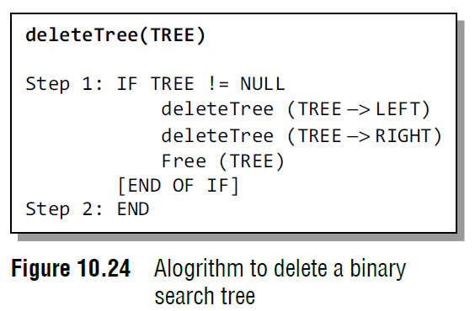
Deleting a Binary Search Tree
To delete/remove an entire binary search tree from the memory, we first delete the elements/nodes in the left sub-tree and then delete the nodes in the right sub-tree.
The algorithm shown in Fig. 10.24 gives a recursive procedure to remove the binary search tree.

Slide 25
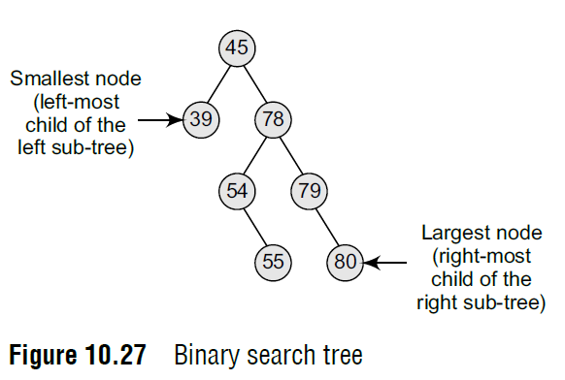
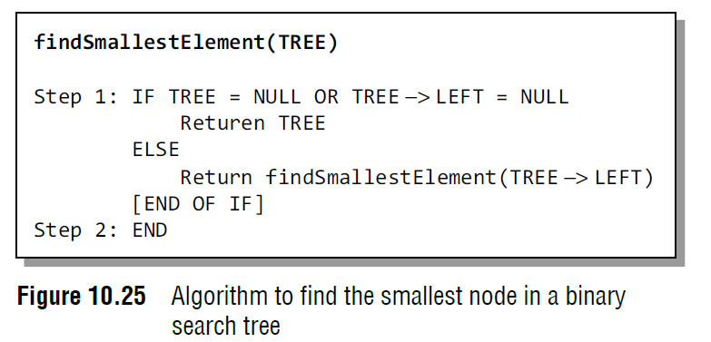
Finding the Smallest Node in a Binary Search Tree
The very basic property of the binary search tree states that the smaller value will occur in the left sub-tree.
If the left sub-tree is NULL, then the value of the root node will be smallest as compared to the nodes in the right sub-tree.
So, to find the node with the smallest value, we find the value of the leftmost node of the left sub-tree.
The recursive algorithm to find the smallest node in a binary search tree is shown in Fig. 10.25.

Slide 26
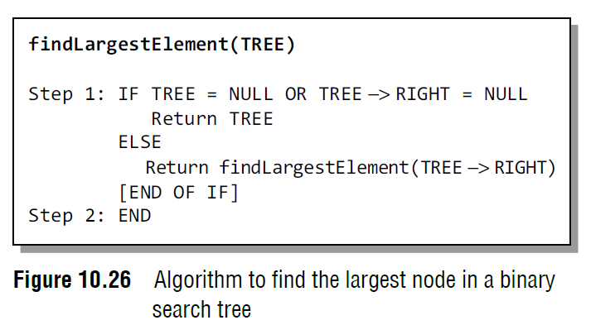
Finding the Largest Node in a Binary Search Tree
To find the node with the largest value, we find the value of the rightmost node of the right subtree.
However, if the right sub-tree is empty, then the root node will be the largest value in the tree.
The recursive algorithm to find the largest node in a binary search tree is shown in Fig. 10.26.

Slide 27
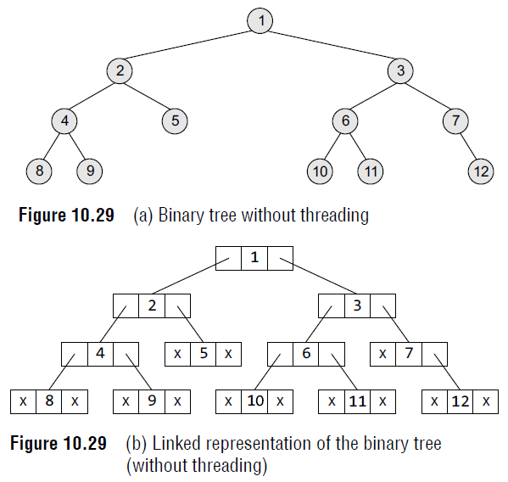
Threaded Binary Trees
A threaded binary tree is the same as that of a binary tree but with a difference in storing the NULL pointers. Consider the linked representation of a binary tree as given in Fig. 10.29.
In the linked representation, a number of nodes contain a NULL pointer, either in their left or right fields or in both.

Slide 28
Threaded Binary Trees
For example, the NULL entries can be replaced to store a pointer to the in-order predecessor or the in-order successor of the node.
These special pointers are called threads and binary trees containing threads are called threaded trees.
In the linked representation of a threaded binary tree, threads will be denoted using arrows.
There are many ways of threading a binary tree and each type may vary according to the way the tree is traversed.
We will discuss in-order traversal of the tree.

Slide 29
Threaded Binary Trees
In one-way threading, a thread will appear either in the right field or the left field of the node. A one-way threaded tree is also called a single-threaded tree.
If the thread appears in the left field, then the left field will be made to point to the in-order predecessor of the node. Such a one-way threaded tree is called a left-threaded binary tree.
On the contrary, if the thread appears in the right field, then it will point to the in-order successor of the node. Such a one-way threaded tree is called a right threaded binary tree.
In a two-way threaded tree, also called a double-threaded tree, threads will appear in both the left and the right field of the node.
While the left field will point to the in-order predecessor of the node, the right field will point to its successor.
A two-way threaded binary tree is also called a fully threaded binary tree.

Slide 30
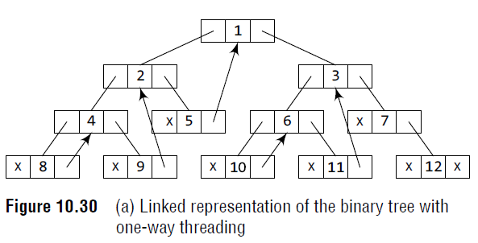
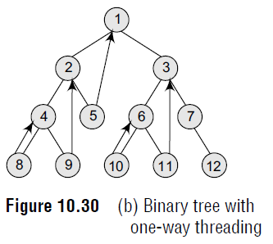
One-way Threading
Figure 10.29 shows a binary tree without threading and its corresponding linked representation.
The in-order traversal of the tree is given as 8, 4, 9, 2, 5, 1, 10, 6, 11, 3, 7, 12
Figure 10.30 shows a binary tree with one-way threading and its corresponding linked representation.
Node 5 contains a NULL pointer in its RIGHT field, so it will be replaced to point to node1, which is its in-order successor.
Similarly, the RIGHT field of node 8 will point to node 4, the RIGHT field of node 9 will point to node 2, the RIGHT field of node 10 will point to node 6, the RIGHT field of node 11 will point to node 3, and the RIGHT field of node 12 will contain NULL because it has no in-order successor.

Slide 31
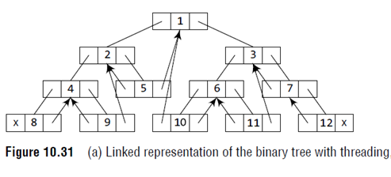
Two-way Threading
Figure 10.31 shows a binary tree with two-way threading and its corresponding linked representation.
Node 5 contains a NULL pointer in its LEFT field, so it will be replaced to point to node 2, which is its in-order predecessor.
Similarly, the LEFT field of node 8 will contain NULL because it has no in-order predecessor, the LEFT field of node 7 will point to node 3, the LEFT field of node 9 will point to node 4, the LEFT field of node 10 will point to node 1, the LEFT field of node 11 will contain 6, and the LEFT field of node 12 will point to node 7.

Slide 32
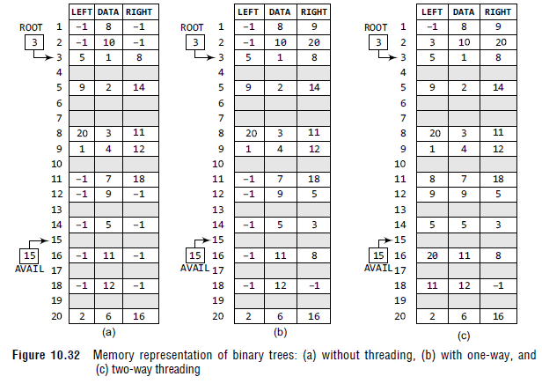
Threaded Binary Trees

Slide 33
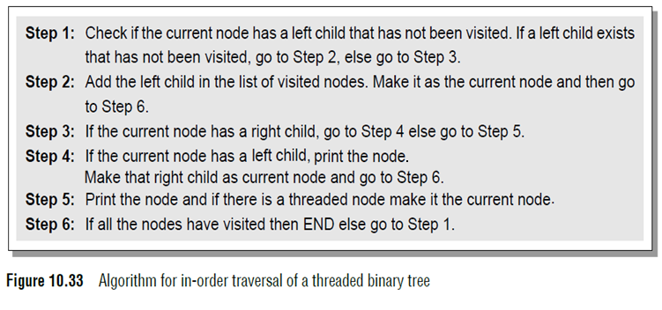
Traversing a Threaded Binary Tree
For every node, visit the left sub-tree first, provided if one exists and has not been visited earlier.
Then the node (root) itself is followed by visiting its right sub-tree (if one exists).
In case there is no right sub-tree, check for the threaded link and make the threaded node the current node in consideration. The algorithm for in-order traversal of a threaded binary tree is given in Fig. 10.33.

Slide 34
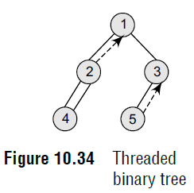
Traversing a Threaded Binary Tree
Let’s consider the threaded binary tree given in Fig. 10.34 and traverse it using the algorithm.
1. Node 1 has a left child i.e., 2 which has not been visited. So, add 2 in the list of visited nodes, make it as the current node.
2. Node 2 has a left child i.e., 4 which has not been visited. So, add 4 in the list of visited nodes, make it as the current node.
3. Node 4 does not have any left or right child, so print 4 and check for its threaded link. It has a threaded link to node 2, so make node 2 the current node.
4. Node 2 has a left child which has already been visited. However, it does not have a right child. Now, print 2 and follow its threaded link to node 1. Make node 1 the current node.
5. Node 1 has a left child that has been already visited. So print 1. Node 1 has a right child 3 which has not yet been visited, so make it the current node.
6. Node 3 has a left child (node 5) which has not been visited, so make it the current node.
7. Node 5 does not have any left or right child. So print 5. However, it does have a threaded link which points to node 3. Make node 3 the current node.
8. Node 3 has a left child which has already been visited. So print 3.
9. Now there are no nodes left, so we end here. The sequence of nodes printed is—4 2 1 5 3.

Slide 35
Advantages of Threaded Binary Tree
It enables linear traversal of elements in the tree.
It enables to find the parent of a given element without explicit use of parent pointers.
Since nodes contain pointers to in-order predecessor and successor, the threaded tree enables forward and backward traversal of the nodes as given by in-order fashion.
Thus, we see the basic difference between a binary tree and a threaded binary tree is that in binary trees a node stores a NULL pointer if it has no child and so there is no way to traverse back.

Slide 36
AVL Trees
AVL tree is a self-balancing binary search tree invented by G.M. Adelson-Velsky and E.M. Landis in 1962.
The tree is named AVL in honour of its inventors.
In an AVL tree, the heights of the two sub-trees of a node may differ by at most one.
Due to this property, the AVL tree is also known as a height-balanced tree.
The key advantage of using an AVL tree is that it takes O(log n) time to perform search, insert, and delete operations in an average case as well as the worst case because the height of the tree is limited to O(log n).

Slide 37
AVL Trees
The structure of an AVL tree is the same as that of a binary search tree but with a little difference.
In its structure, it stores an additional variable called the BalanceFactor. Thus, every node has a balance factor associated with it.
The balance factor of a node is calculated by subtracting the height of its right sub-tree from the height of its left sub-tree.
Balance factor = Height (left sub-tree)
– Height (right sub-tree)
A binary search tree in which every node has a balance factor of –1, 0, or 1 is said to be height balanced.
A node with any other balance factor is considered to be unbalanced and requires rebalancing of the tree.

Slide 38
AVL Trees
Balance factor = Height (left sub-tree)
– Height (right sub-tree)
If the balance factor of a node is 1, then it means that the left sub-tree of the tree is one level higher than that of the right sub-tree.
Such a tree is therefore called as a left-heavy tree.
If the balance factor of a node is 0, then it means that the height of the left sub-tree (longest path in the left sub-tree) is equal to the height of the right sub-tree.
If the balance factor of a node is –1, then it means that the left sub-tree of the tree is one level lower than that of the right sub-tree. Such a tree is therefore called as a right-heavy tree.

Slide 39
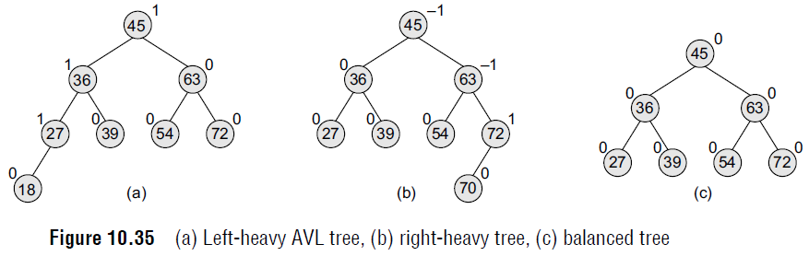
AVL Trees
Look at Fig. 10.35. Note that the nodes 18, 39, 54, and 72 have no children, so their balance factor = 0.
Node 27 has one left child and zero right child. So, the height of left sub-tree = 1, whereas the height of right sub-tree = 0. Thus, its balance factor = 1.
Look at node 36, it has a left sub-tree with height = 2, whereas the height of right sub-tree = 1. Thus, its balance factor = 2 – 1 =1. Similarly, the balance factor of node 45 = 3 – 2 =1; and node 63 has a balance factor of 0 (1 – 1).
Now, look at Figs 10.35 (b) and (c) which show a right-heavy AVL tree and a balanced AVL tree.

Slide 40
AVL Trees
The trees given in Fig. 10.35 are typical candidates of AVL trees because the balancing factor of every node is either 1, 0, or –1.
However, insertions and deletions from an AVL tree may disturb the balance factor of the nodes and, thus, rebalancing of the tree may have to be done. The tree is rebalanced by performing rotation at the critical node.
There are four types of rotations: LL rotation, RR rotation, LR rotation, and RL rotation.
The type of rotation that has to be done will vary depending on the particular situation.

Slide 41
Searching for a Node in an AVL Tree
Searching in an AVL tree is performed exactly the same way as it is performed in a binary search tree.
Due to the height-balancing of the tree, the search operation takes O(log n) time to complete.
Since the operation does not modify the structure of the tree, no special provisions are required.

Slide 42
Inserting a New Node in an AVL Tree
Insertion in an AVL tree is also done in the same way as it is done in a binary search tree.
In the AVL tree, the new node is always inserted as the leaf node. But the step of insertion is usually followed by an additional step of rotation.
Rotation is done to restore the balance of the tree.
However, if insertion of the new node does not disturb the balance factor, that is, if the balance factor of every node is still –1, 0, or 1, then rotations are not required.

Slide 43
Inserting a New Node in an AVL Tree
During insertion, the new node is inserted as the leaf node, so it will always have a balance factor equal to zero.
The only nodes whose balance factors will change are those which lie in the path between the root of the tree and the newly inserted node.
The possible changes which may take place in any node on the path are as follows:
Initially, the node was either left- or right-heavy and after insertion, it becomes balanced.
Initially, the node was balanced and after insertion, it becomes either left- or right-heavy.
Initially, the node was heavy (either left or right) and the new node has been inserted in the heavy sub-tree, thereby creating an unbalanced sub-tree. Such a node is said to be a critical node.

Slide 44
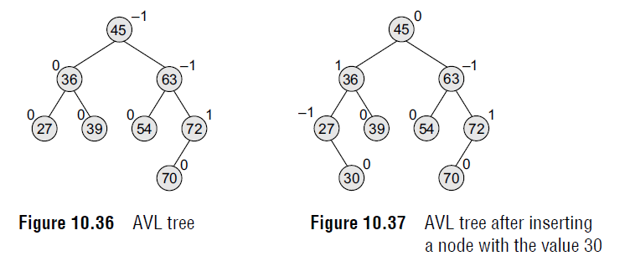
Inserting a New Node in an AVL Tree
If we insert a new node with the value 30, then the new tree will still be balanced and no rotations will be required in this case.
Look at the tree given in Fig. 10.37 which shows the tree after inserting node 30.

Slide 45
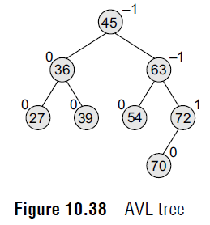
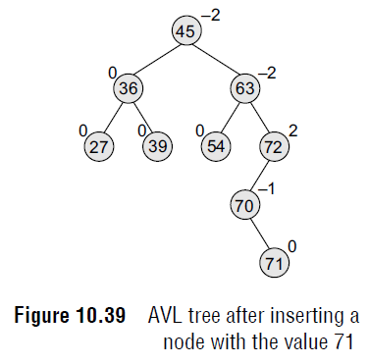
Inserting a New Node in an AVL Tree
After inserting a new node with the value 71, the new tree will be as shown in Fig. 10.39. Note that there are three nodes in the tree that have their balance factors 2, –2, and –2, thereby disturbing the AVLness of the tree.
So, here comes the need to perform rotation.
To perform rotation, our first task is to find the critical node. Critical node is the nearest ancestor node on the path from the inserted node to the root whose balance factor is neither –1, 0, nor 1. In the tree given above, the critical node is 72.
The second task in rebalancing the tree is to determine which type of rotation has to be done.
There are four types of rebalancing rotations and application of these rotations depends on the position of the inserted node with reference to the critical node.

Slide 46
Inserting a New Node in an AVL Tree
The four categories of rotations are:
Left Left Rotation (LL rotation): The new node is inserted in the left sub-tree of the left sub-tree of the critical node.
Right Right Rotation (RR rotation): The new node is inserted in the right sub-tree of the right sub-tree of the critical node.
Left Right Rotation (LR rotation): The new node is inserted in the right sub-tree of the left sub-tree of the critical node.
Right Left Rotation (RL rotation): The new node is inserted in the left sub-tree of the right sub-tree of the critical node.

Slide 47
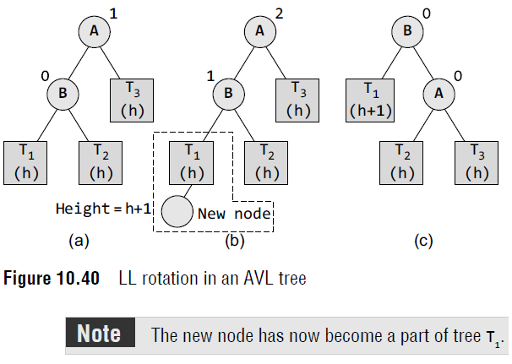
Inserting a New Node in an AVL Tree
LL Rotation
A single right rotation is performed. This type of rotation is identified when a node has a balanced factor as +2, and its left-child has a balance factor as +1.
First, we will see where and how LL rotation is applied. Consider the tree given in Fig.10.40 which shows an AVL tree.
Tree (a) is an AVL tree. In tree (b), a new node is inserted in the left sub-tree of the left sub-tree of the critical node A (node A is the critical node because it is the closest ancestor whose balance factor is not –1, 0, or 1), so we apply LL rotation as shown in tree (c).
While rotation, node B becomes the root, with T1 and A as its left and right child. T2 and T3 become the left and right sub-trees of A.

Slide 48
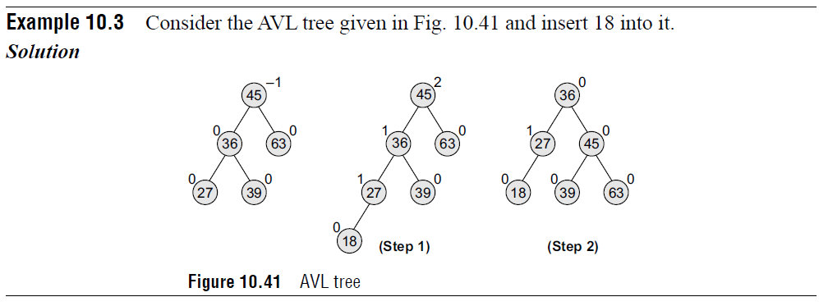
Inserting a New Node in an AVL Tree

Slide 49
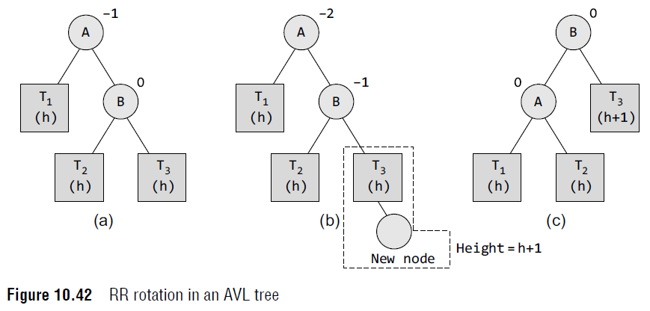
Inserting a New Node in an AVL Tree
RR Rotation
A single left rotation is performed. This type of rotation is identified when a node has a balanced factor as -2, and its right-child has a balance factor as -1.
Tree (a) is an AVL tree.
In tree (b), a new node is inserted in the right sub-tree of the right sub-tree of the critical node A (node A is the critical node because it is the closest ancestor whose balance factor is not –1, 0, or 1), so we apply RR rotation as shown in tree (c).
While rotation, node B becomes the root, with A and T3 as its left and right child. T1 and T2 become the left and right sub-trees of A.

Slide 50
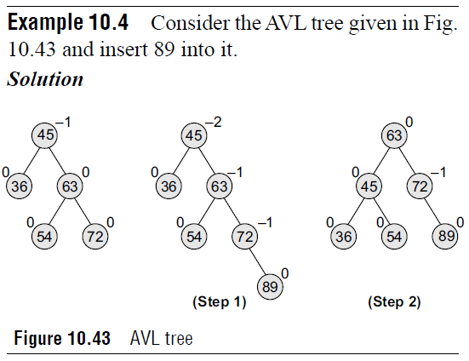
Inserting a New Node in an AVL Tree

Slide 51
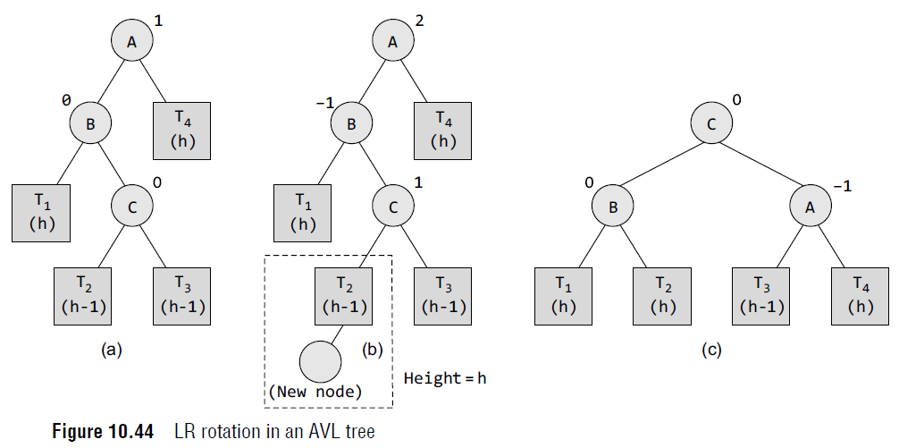
Inserting a New Node in an AVL Tree
LR and RL Rotations
Consider the AVL tree given in Fig. 10.44 and see how LR r Tree (a) is an AVL tree. In tree (b), a new node is inserted in the right sub-tree of the left sub-tree of the critical node A (node A is the critical node because it is the closest ancestor whose balance factor is not –1, 0 or 1), so we apply LR rotation as shown in tree (c).
Note that the new node has now become a part of tree T2. While rotation, node C becomes the root, with B and A as its left and right children.
Node B has T1 and T2 as its left and right sub-trees and T3 and T4 become the left and right sub-trees of node A.

Slide 52
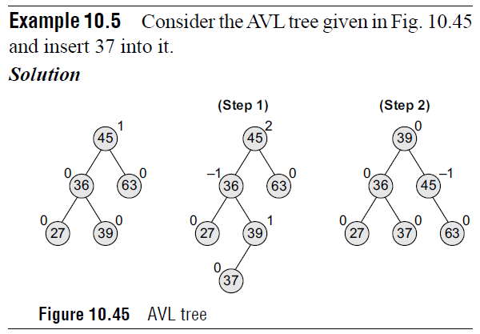
Inserting a New Node in an AVL Tree

Slide 53
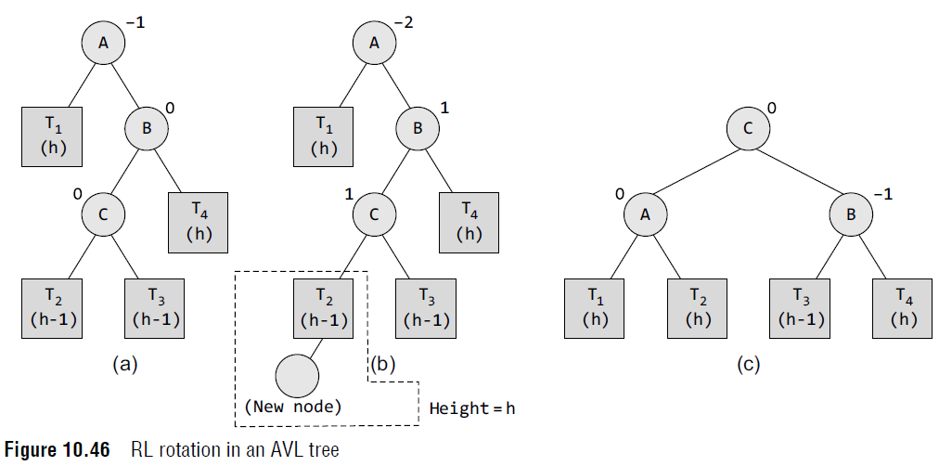
Inserting a New Node in an AVL Tree
LR and RL Rotations
Now, consider the AVL tree given in Fig.10.46 and see how RL rotation is done to rebalance the tree.
Tree (a) is an AVL tree. In tree (b), a new node is inserted in the left sub-tree of the right sub-tree of the critical node A (node A is the critical node because it is the closest ancestor whose balance factor is not –1, 0, or 1), so we apply RL rotation as shown in tree (c).
While rotation, node C becomes the root, with A and B as its left and right children.
Node A has T1 and T2 as its left and right sub-trees and T3 and T4 become the left and right sub-trees of node B.

Slide 54
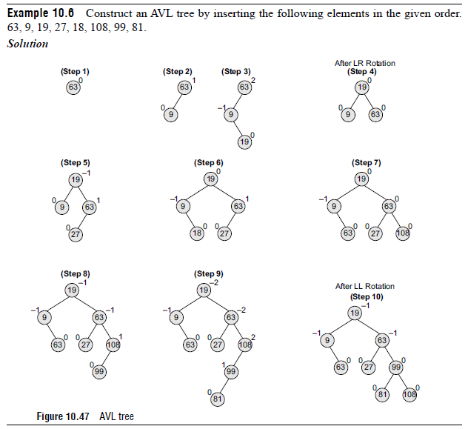
Inserting a New Node in an AVL Tree

Slide 55
Deleting a node from an AVL Tree
Deletion of a node in an AVL tree is similar to that of binary search trees. But it goes one step ahead.
Deletion may disturb the AVLness of the tree, so to rebalance the AVL tree, we need to perform rotations. There are two classes of rotations that can be performed on an AVL tree after deleting a given node.
These rotations are R rotation and L rotation.
On deletion of node X from the AVL tree, if node A becomes the critical node (closest ancestor node on the path from X to the root node that does not have its balance factor as 1, 0, or –1), then the type of rotation depends on whether X is in the left sub-tree of A or in its right sub-tree.
If the node to be deleted is present in the left sub-tree of A, then L rotation is applied, else if X is in the right sub-tree, R rotation is performed.
Further, there are three categories of L and R rotations. The variations of L rotation are L–1, L0, and L1 rotation. Correspondingly for R rotation, there are R0, R–1, and R1 rotations.
In this section, we will discuss only R rotation. L rotations are the mirror images of R rotations.

Slide 56
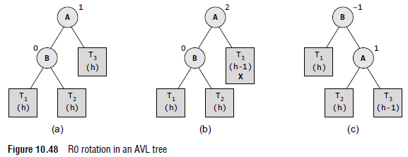
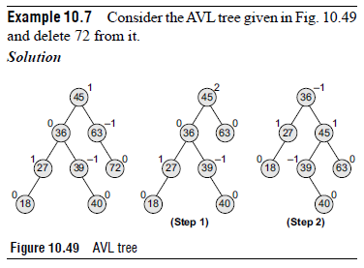
Deleting a node from an AVL Tree
R0 Rotation
Let B be the root of the left or right sub-tree of A (critical node). R0 rotation is applied if the balance factor of B is 0. This is illustrated in Fig. 10.48.
Tree (a) is an AVL tree. In tree (b), the node X is to be deleted from the right sub-tree of the critical node A (node A is the critical node because it is the closest ancestor whose balance factor is not –1, 0, or 1). Since the balance factor of node B is 0, we apply R0 rotation as shown in tree (c).
During the process of rotation, node B becomes the root, with T1 and A as its left and right child.
T2 and T3 become the left and right sub-trees of A.

Slide 57
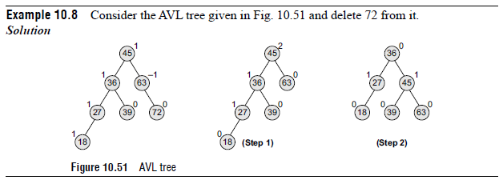
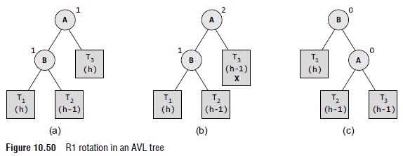
Deleting a node from an AVL Tree
R1 Rotation
Let B be the root of the left or right sub-tree of A (critical node). R1 rotation is applied if the balance factor of B is 1. Observe that R0 and R1 rotations are similar to LL rotations; the only difference is that R0 and R1 rotations yield different balance factors.
Tree (a) is an AVL tree. In tree (b), the node X is to be deleted from the right sub-tree of the critical node A (node A is the critical node because it is the closest ancestor whose balance factor is not –1, 0, or 1).
Since the balance factor of node B is 1, we apply R1 rotation as shown in tree (c).
During the process of rotation, node B becomes the root, with T1 and A as its left and right children. T2 and T3 become the left and right sub-trees of A.

Slide 58
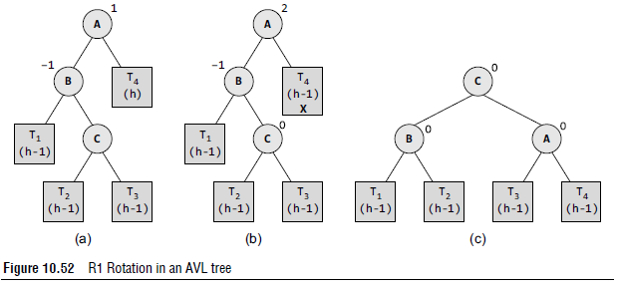
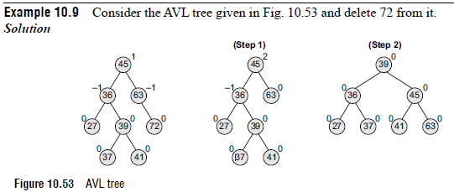
Deleting a node from an AVL Tree
R–1 Rotation
Let B be the root of the left or right sub-tree of A (critical node). R–1 rotation is applied if the balance factor of B is –1.
Observe that R–1 rotation is similar to LR rotation. Tree (a) is an AVL tree. In tree (b), the node X is to be deleted from the right sub-tree of the critical node A (node A is the critical node because it is the closest ancestor whose balance factor is not –1, 0 or 1).
Since the balance factor of node B is –1, we apply R–1 rotation as shown in tree (c).
While rotation, node C becomes the root, with T1 and A as its left and right child. T2 and T3 become he left and right sub-trees of A.

Slide 59

Deleting a node from an AVL Tree

Slide 60
Red-Black Trees
A red-black tree is a self-balancing binary search tree that was invented in 1972 by Rudolf Bayer who called it the ‘symmetric binary B-tree’.
Although a red-black tree is complex, it has good worst case running time for its operations and is efficient to use as searching, insertion, and deletion can all be done in O(log n) time, where n is the number of nodes in the tree.
Practically, a red-black tree is a binary search tree which inserts and removes intelligently, to keep the tree reasonably balanced.
A special point to note about the red-black tree is that in this tree, no data is stored in the leaf nodes.

Slide 61

Red-Black Trees
Properties of Red-Black Trees
A red-black tree is a binary search tree in which every node has a color which is either red or black.
Apart from the other restrictions of a binary search tree, the red-black tree has the following additional requirements:
1. The color of a node is either red or black.
2. The color of the root node is always black.
3. All leaf nodes are black.
4. Every red node has both the children colored in black.
5. Every simple path from a given node to any of its leaf nodes has an equal number of black nodes.

Slide 62
Red-Black Trees
These constraints enforce a critical property of red-black trees. The longest path from the root node to any leaf node is no more than twice as long as the shortest path from the root to any other leaf in that tree.
This results in a roughly balanced tree. Since operations such as insertion, deletion, and searching require worst-case times proportional to the height of the tree, this theoretical upper bound on the height allows red-black trees to be efficient in the worst case, unlike ordinary binary search trees.
To understand the importance of these properties, it suffices to note that according to property 4, no path can have two red nodes in a row.
The shortest possible path will have all black nodes, and the longest possible path would alternately have a red and a black node.
Since all maximal paths have the same number of black nodes (property 5), no path is more than twice as long as any other path.

Slide 63
Operations on Red-Black Trees
Performing a read-only operation (like traversing the nodes in a tree) on a red-black tree requires no modification from those used for binary search trees.
Remember that every red-black tree is a special case of a binary search tree.
However, insertion and deletion operations may violate the properties of a red-black tree.
Inserting a Node in a Red-Black Tree
The insertion operation starts in the same way as we add a new node in the binary search tree.
However, in a binary search tree, we always add the new node as a leaf, while in a red-black tree, leaf nodes contain no data.
So instead of adding the new node as a leaf node, we add a red interior node that has two black leaf nodes.

Slide 64
Operations on Red-Black Trees
Inserting a Node in a Red-Black Tree
Once a new node is added, it may violate some properties of the red-black tree.
So in order to restore their property, we check for certain cases and restore the property depending on the case that turns up after insertion.
But before learning these cases in detail, first let us discuss certain important terms that will be used.
Grandparent node (G) of a node (N) refers to the parent of N’s parent (P), as in human family trees.
The C code to find a node’s grandparent can be given as follows:
struct node * grand_parent(struct node *n)
{
// No parent means no grandparent
if ((n != NULL) && (n -> parent != NULL))
return n -> parent -> parent;
else
return NULL;
}

Slide 65
Operations on Red-Black Trees
Inserting a Node in a Red-Black Tree
Uncle node (U) of a node (N) refers to the sibling of N’s parent (P), as in human family trees.
The C code to find a node’s uncle can be given as follows:
struct node *uncle(struct node *n)
{
struct node *g;
g = grand_parent(n);
//With no grandparent, there cannot be any uncle
if (g == NULL)
return NULL;
if (n -> parent == g -> left)
return g -> right;
else
return g -> left;
}

Slide 66
Operations on Red-Black Trees
Inserting a Node in a Red-Black Tree
When we insert a new node in a red-black tree, note the following:
All leaf nodes are always black. So property 3 always holds true.
Property 4 (both children of every red node are black) is threatened only by adding a red node, repainting a black node red, or a rotation.
Property 5 (all paths from any given node to its leaf nodes has equal number of black nodes) is threatened only by adding a black node, repainting a red node black, or a rotation.

Slide 67
Operations on Red-Black Trees
Inserting a Node in a Red-Black Tree
Case 1: The New Node N is Added as the Root of the Tree
In this case, N is repainted black, as the root of the tree is always black.
Since N adds one black node to every path at once, Property 5 is not violated.
The C code for case 1 can be given as follows:
void case1(struct node *n)
{
if (n -> parent == NULL) // Root node
n -> colour = BLACK;
else
case2(n);
}

Slide 68
Operations on Red-Black Trees
Inserting a Node in a Red-Black Tree
Case 2: The New Node’s Parent P is Black
In this case, both children of every red node are black, so Property 4 is not invalidated.
Property 5 is also not threatened. This is because the new node N has two black leaf children, but because N is red, the paths through each of its children have the same number of black nodes.
The C code to check for case 2 can be given as follows:
void case2(struct node *n)
{
if (n -> parent -> colour == BLACK)
return;
/* Red black tree property is not violated*/
else
case3(n);
}
In the following cases, it is assumed that N has a grandparent node G, because its parent P is red, and if it were the root, it would be black. Thus, N also has an uncle node U (irrespective of whether U is a leaf node or an internal node).

Slide 69
Operations on Red-Black Trees
Inserting a Node in a Red-Black Tree
Case 3: If Both the Parent (P) and the Uncle (U) are Red
In this case, Property 4 is violated. Insertion in the third case is illustrated in Fig. 10.57.
In order to restore Property 4, both nodes (P and U) are repainted black and the grandparent G is repainted red.
Now, the new red node N has a black parent. Since any path through the parent or uncle must pass through the grandparent, the number of black nodes on these paths has not changed.
However, the grandparent G may now violate Property 2 which says that the root node is always black or Property 4 which states that both children of every red node are black.
Property 4 will be violated when G has a red parent. In order to fix this problem, this entire procedure is recursively performed on G from Case 1.

Slide 70

Operations on Red-Black Trees
Inserting a Node in a Red-Black Tree
Case 3: The C code to deal with Case 3 insertion is as follows:
void case3(struct node *n)
{
struct node *u, *g;
u = uncle (n);
g = grand_parent(n);
if ((u != NULL) && (u -> colour == RED)) {
n -> parent -> colour = BLACK;
u -> colour = BLACK;
g -> colour = RED;
case1(g);
}
else {
insert_case4(n);
}
}

Slide 71

Operations on Red-Black Trees
Inserting a Node in a Red-Black Tree
Case 4: The Parent P is Red but the Uncle U is Black and N is the Right Child of P and P is the Left Child of G
In order to fix this problem, a left rotation is done to switch the roles of the new node N and its parent P.
After the rotation, note that in the C code, we have re-labelled N and P and then, case 5 is called to deal with the new node’s parent. This is done because Property 4 which says both children of every red node should be black is still violated.
Figure 10.58 illustrates Case 4 insertion. Note that in case N is the left child of P and P is the right child of G, we have to perform a right rotation. In the C code that handles Case 4, we check for P and N and then, perform either a left or a right rotation.

Slide 72
Operations on Red-Black Trees
Inserting a Node in a Red-Black Tree
void case4(struct node *n)
{
struct node *g = grand_parent(n);
if ((n == n -> parent -> right) && (n -> parent == g -> left))
{
rotate_left(n -> parent);
n = n -> left;
}
else if ((n == n -> parent -> left) && (n -> parent == g -> right))
{
rotate_right(n -> parent);
n = n -> right;
}
case5(n);
}

Slide 73

Operations on Red-Black Trees
Inserting a Node in a Red-Black Tree
Case 5: The Parent P is Red but the Uncle U is Black and the New Node N is the Left Child of P, and P is the Left Child of its Parent G.
In order to fix this problem, a right rotation on G (the grandparent of N) is performed.
After this rotation, the former parent P is now the parent of both the new node N and the former grandparent G.
We know that the colour of G is black (because otherwise its former child P could not have been red), so now switch the colours of P and G so that the resulting tree satisfies Property 4 which states that both children of a red node are black.
Note that in case N is the right child of P and P is the right child of G, we perform a left rotation.

Slide 74
Operations on Red-Black Trees
Inserting a Node in a Red-Black Tree
In the C code that handles Case 5, we check for P and N and then, perform either a left or a right rotation.
void case5(struct node *n)
{
struct node *g;
g = grandparent(n);
if ((n == n -> parent -> left) && (n -> parent == g -> left))
rotate_right(g);
else if ((n == n -> parent -> right) && (n -> parent == g -> right))
rotate_left(g);
n -> parent -> colour = BLACK;
g -> colour = RED;
}

Slide 75
Operations on Red-Black Trees
Deleting a Node from a Red-Black Tree
When we delete a node with two non-leaf children, we find either the maximum element in its left sub-tree of the node or the minimum element in its right sub-tree, and move its value into the node being deleted. We delete the node from which we had copied the value.
In this section, we will assume that we are deleting a node with at most one non-leaf child, which we will call its child. In case this node has both leaf children, then let one of them be its child.
While deleting a node, if its colour is red, then we can simply replace it with its child, which must be black.
All paths through the deleted node will simply pass through one less red node, and both the deleted node’s parent and child must be black, so none of the properties will be violated.
Another simple case is when we delete a black node that has a red child. In this case, property 4 and property 5 could be violated, so to restore them, just repaint the deleted node’s child with black.
However, a complex situation arises when both the node to be deleted as well as its child is black. In this case, we begin by replacing the node to be deleted with its child.

Slide 76
Operations on Red-Black Trees
Deleting a Node from a Red-Black Tree
In the C code, we label the child node as (in its new position) N, and its sibling (its new parent’s other child) as S.
The C code to find the sibling of a node can be given as follows:
struct node *sibling(struct node *n)
{
if (n == n -> parent -> left)
return n -> parent -> right;
else
return n -> parent -> left;
}

Slide 77
Operations on Red-Black Trees
Deleting a Node from a Red-Black Tree
We can start the deletion process by using the following code, where the function copy node substitutes the child into N’s place in the tree.
For convenience, we assume that null leaves are represented by actual node objects, rather than NULL.
void delete_child(struct node *n)
{
/* If N has at most one non–null child */
struct node *child;
if (is_leaf(n -> right))
child = n -> left;
else
child = n -> right;
copy_node(n, child);
if (n -> colour == BLACK) {
if (child -> colour == RED)
child -> colour = BLACK;
else
del_case1(child);
}
delete(n);
}
When both N and its parent P are black, then deleting P will cause paths which precede through N to have one fewer black nodes than the other paths. This will violate Property 5.
Therefore, the tree needs to be rebalanced. There are several cases to consider, which are discussed below.

Slide 78
Operations on Red-Black Trees
Deleting a Node from a Red-Black Tree
Case 1: N is the New Root
In this case, we have removed one black node from every path, and the new root is black, so none of the properties are violated.
void del_case1(struct node *n)
{
if (n -> parent != NULL)
del_case2(n);
}
Note In cases 2, 5, and 6, we assume N is the left child of its parent P. If it is the right child, left and right should be interchanged throughout these three cases.

Slide 79
Operations on Red-Black Trees
Deleting a Node from a Red-Black Tree
Case 2: Sibling S is Red
In this case, interchange the colors of P and S, and then rotate left at P. In the resultant tree, S will become N’s grandparent.
Figure 10.60 illustrates Case 2 deletion.
The C code that handles case 2 deletion can be given as follows:
void del_case2(struct node *n)
{
struct node *s;
s = sibling(n);
if (s -> colour == RED)
{
if (n == n -> parent -> left)
rotate_left(n -> parent);
else
rotate_right(n -> parent);
n -> parent -> colour = RED;
s -> colour = BLACK;
}
del_case3(n);
}

Slide 80

Operations on Red-Black Trees
Deleting a Node from a Red-Black Tree
Case 2: Sibling S is Red

Slide 81
Operations on Red-Black Trees
Deleting a Node from a Red-Black Tree
Case 3: P, S, and S’s Children are Black
In this case, simply repaint S with red. In the resultant tree, all the paths passing through S will have one less black node.
Therefore, all the paths that pass through P now have one fewer black nodes than the paths that do not pass through P, so Property 5 is still violated.
To fix this problem, we perform the rebalancing procedure on P, starting at Case 1. Case 3 is illustrated in Fig. 10.61.
The C code for Case 3 can be given as follows:
void del_case3(struct node *n)
{
struct node *s;
s = sibling(n);
if ((n -> parent -> colour == BLACK) && (s -> colour == BLACK) && (s -> left -> colour == BLACK) &&
(s -> right -> colour == BLACK))
{
s -> colour = RED;
del_case1(n -> parent);
} else
del_case4(n);
}

Slide 82

Operations on Red-Black Trees
Deleting a Node from a Red-Black Tree
Case 3: P, S, and S’s Children are Black

Slide 83
Operations on Red-Black Trees
Deleting a Node from a Red-Black Tree
Case 4: S and S’s Children are Black, but P is Red
In this case, we interchange the colours of S and P.
Although this will not affect the number of black nodes on the paths going through S, it will add one black node to the paths going through N, making up for the deleted black node on those paths.
The C code to handle Case 4 is as follows:
void del_case4(struct node *n)
{
struct node *s;
s = sibling(n);
if((n->parent -> color = = RED ) & & ( s -> colour = = BLACK) & & (s -> left -> colour == BLACK) && (s -> right -> colour == BLACK))
{
s -> colour = RED;
n -> parent -> colour = BLACK;
} else
del_case5(n);
}

Slide 84

Operations on Red-Black Trees
Deleting a Node from a Red-Black Tree
Case 4: S and S’s Children are Black, but P is Red

Slide 85
Operations on Red-Black Trees
Deleting a Node from a Red-Black Tree
Case 5: N is the Left Child of P and S is Black, S’s Left Child is Red, S’s Right Child is Black.
In this case, perform a right rotation at S. After the rotation, S’s left child becomes S’s parent and N’s new sibling. Also, interchange the colours of S and its new parent.
Note that now all paths still have equal number of black nodes, but N has a black sibling whose right child is red, so we fall into Case 6.

Slide 86
Operations on Red-Black Trees
Deleting a Node from a Red-Black Tree
Case 5: N is the Left Child of P and S is Black, S’s Left Child is Red, S’s Right Child is Black.
The C code to handle case 5 is given as follows:
void del_case5(struct node *n)
{
struct node *s;
s = sibling(n);
if (s -> colour == BLACK)
{
/* the following code forces the red to be on the left of the left of the parent, or right of the right, to be correctly operated in case 6. */
if ((n == n -> parent -> left) && (s -> right -> colour == BLACK) && (s -> left
-> colour == RED))
rotate_right(s);
else if ((n == n -> parent -> right) && (s -> left -> colour == BLACK) && (s ->
right -> colour == RED))
rotate_left(s);
s -> colour = RED;
s -> right -> colour = BLACK;
}
del_case6(n);
}

Slide 87

Operations on Red-Black Trees
Deleting a Node from a Red-Black Tree
Case 5: N is the Left Child of P and S is Black, S’s Left Child is Red, S’s Right Child is Black.

Slide 88
Operations on Red-Black Trees
Deleting a Node from a Red-Black Tree
Case 6: S is Black, S’s Right Child is Red, and N is the Left Child of its Parent P
In this case, a left rotation is done at P to make S the parent of P and S’s right child. After the rotation, the colours of P and S are interchanged and S’s right child is coloured black. Once these steps are followed, you will observe that property 4 and property 5 remain valid.
The C code to fix Case 6 can be given as follows:
void del_case6(struct node *n)
{
struct node *s;
s = sibling(n);
s -> colour = n -> parent -> colour;
n -> parent -> colour = BLACK;
if (n == n -> parent -> left) {
s -> right -> colour = BLACK;
rotate_left(n -> parent);
} else {
s -> left -> colour = BLACK;
rotate_right(n -> parent);
}
}

Slide 89

Operations on Red-Black Trees
Deleting a Node from a Red-Black Tree
Case 6: S is Black, S’s Right Child is Red, and N is the Left Child of its Parent P

